Slide 1
Chapter 2
End-to-end machine learning project

Slide 2
Machine learning checklist (project lifecycle)
Frame the problem and look at the big picture
“Building a model is probably not the goal”. How does the client expect to USE AND BENEFIT from the model?
Get the data
Explore the data to gain insights
Prepare the data to better expose the underlying data patterns to Machine Learning Algorithms
Explore many different models and short-list the best ones
Fine-tune you models and combine them into a great solution
Present your solution
Launch, monitor, and maintain your system

Slide 3
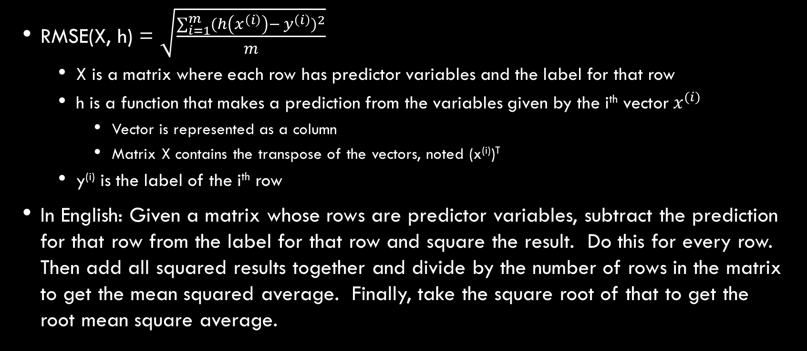
Performance measures
RMSE(X, h) = $\sqrt{\frac{\sum_{i=1}^{m}{{(h\left(x^{\left(i\right)}\right)− y^{\left(i\right)})}^{2}}}{m}}$
X is a matrix where each row has predictor variables and the label for that row
h is a function that makes a prediction from the variables given by the i^{th} vector${ x}^{(i)}$
Vector is represented as a column
Matrix X contains the transpose of the vectors, noted (x^{(i)})^{T}
y^{(i)} is the label of the i^{th} row
In English: Given a matrix whose rows are predictor variables, subtract the prediction for that row from the label for that row and square the result. Do this for every row. Then add all squared results together and divide by the number of rows in the matrix to get the mean squared average. Finally, take the square root of that to get the root mean square average.

Slide 4
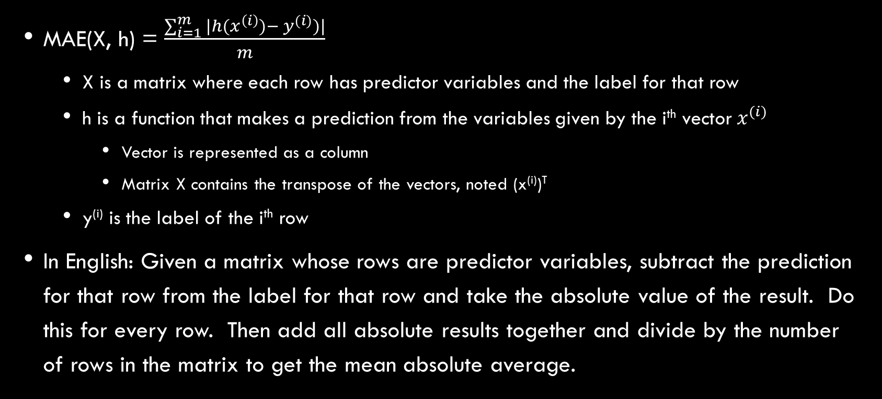
Performance measures
MAE(X, h) = $\frac{\sum_{i=1}^{m}{|h(x^{\left(i\right)})− y^{(i)})|}}{m}$
X is a matrix where each row has predictor variables and the label for that row
h is a function that makes a prediction from the variables given by the i^{th} vector${ x}^{(i)}$
Vector is represented as a column
Matrix X contains the transpose of the vectors, noted (x^{(i)})^{T}
y^{(i)} is the label of the i^{th} row
In English: Given a matrix whose rows are predictor variables, subtract the prediction for that row from the label for that row and take the absolute value of the result. Do this for every row. Then add all absolute results together and divide by the number of rows in the matrix to get the mean absolute average.

Slide 5
Performance measures - comparison
Both RMSE and MAE measure the distance between the vector of predictions and the vector of target values
RMSE
“The notion of distance you are familiar with” (Euclidean Norm)
Affected more by outliers
Performs very well and is generally preferred where outliers are rare, as in bell shaped curves
MAE
Less affected by outliers

Slide 6
“Some Algorithms” overview
It will be harder for some algorithms to detect patterns if data is skewed, pg. 49
Most algorithms cannot work with missing features, pg. 61
Most algorithms prefer to work with numbers, pg. 63
Most algorithms don’t perform well when the input numerical attributes have different scales, pg. 66

Slide 7
Terminology review
Signal – A piece of information fed to an ML algorithm
Pipeline – A sequence of data processing components
Label – Expected output
Multiple regression problem – The system will use multiple features to make a prediction
Univariate regression problem – Trying to predict a single value for each data set
Multivariate regression problem – Trying to predict multiple values for each data set

Slide 8
Terminology review
Norm – measure of distance between two vectors
Euclidean Norm (see RMSE) – “The notion of distance you are familiar with”
Manhattan Norm (see MAE) – “The distance between two points in a city if you have can only travel along orthogonal blocks”
Standard deviation – “measures how dispersed values are”
Square root of the variance
Variance – Average of the squared deviation from the mean
Normal Distribution (Gaussian Distribution) – Bell shaped distribution
68, 95, 99.7 rule

Slide 9
Terminology review
Percentiles – “Indicates the value below which a given percentage of observations in a group of observations falls”
Quartile – 25th, 50th, 75th percentiles
Tail heavy – The data is skewed. In the case of the book, several feature’s histograms extended further to the right (skewed right). See additional information for a link to a discussion on how tail-heavy data may impact a data analyst

Slide 10
Terminology review
Data snooping – estimating the generalization error using the test set
Stratified sampling – population divided into homogeneous subgroups, called strata, and the right number of instances are sampled from each stratum to guarantee that the test set is representative of the population
Standard correlation coefficient (Pearson’s r) – measures linear correlations between a predictor and the target

Slide 11
Terminology review
One-hot encoding – basically a matrix where one element on each row is a one and all other elements are zeros. The one represents the value of the category for that row, pg. 64
Embeddings – alternative to one-hot encoding when there are a large number of categorical values possible (requires a good understanding of NN, chapter 14)
Feature scaling – transforming your input numerical attributes to all have the same scale

Slide 12
Terminology review
Normalization (min-max scaling) – transforming numerical features to all have value from 0 to 1
K-fold cross validation – split the training set into k subsets (folds), then train the model on k-1 folds and evaluate against the remaining fold
Ensemble learning – building a model on top of many other models
Regularization (chapter 1) – constraining a model to make it simpler and reduce the risk of overfitting

Slide 13
Terminology review
Hyperparameter (chapter 1) – A parameter of the learning algorithm (not of the model)

Slide 14
Additional information
Microsoft data science lifecyle: https://docs.microsoft.com/en-us/azure/machine-learning/team-data-science-process/overview
RMSE vs Standard Deviation: https://stats.stackexchange.com/questions/264906/rmse-vs-standard-deviation-in-population
Discussion of tail-heavy data: https://www.itl.nist.gov/div898/handbook/eda/section3/histogr6.htm
Data science, explained by the government (chapter 3 may be of interest, but looks good all around): https://www.itl.nist.gov/div898/handbook/
Basically this chapter, except on Kaggle. So you get the benefit of all the discussion and other people’s notebooks: https://www.kaggle.com/c/house-prices-advanced-regression-techniques

